Slide 1
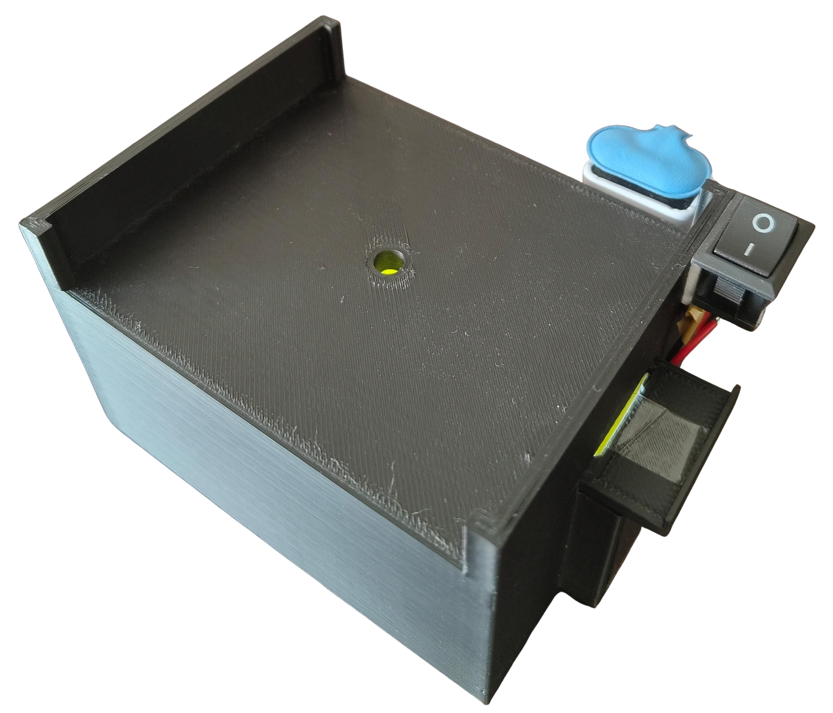
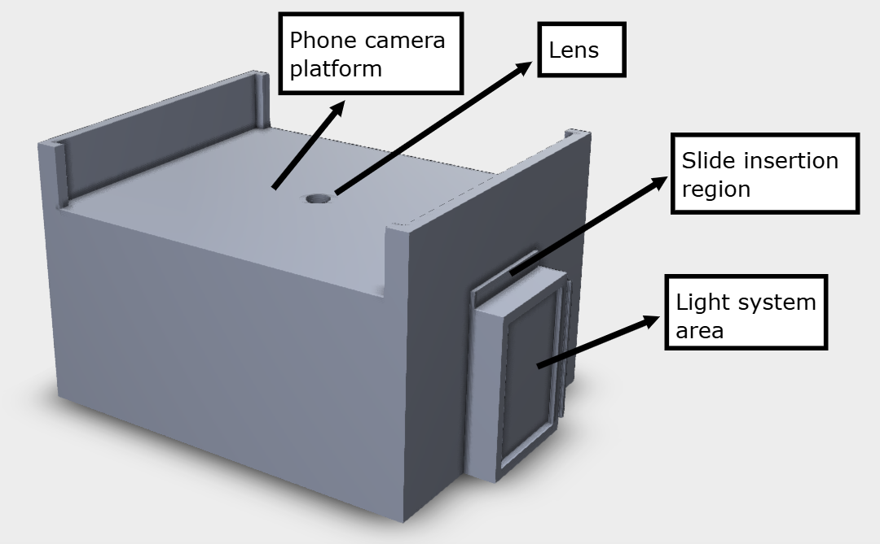
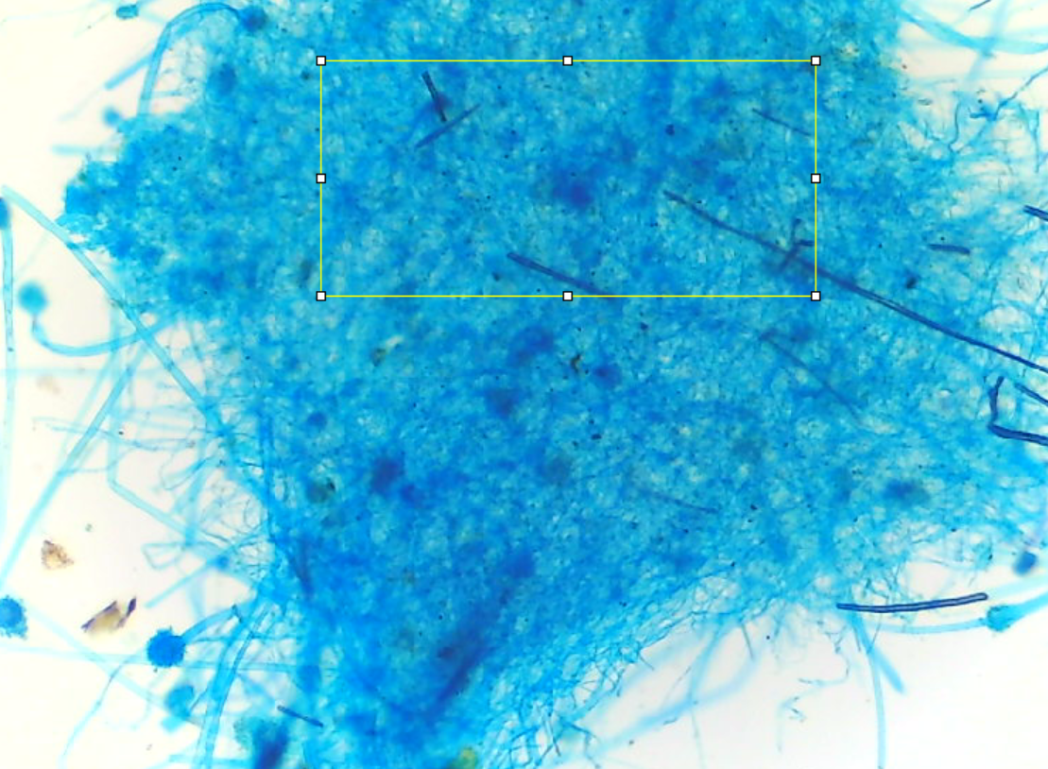
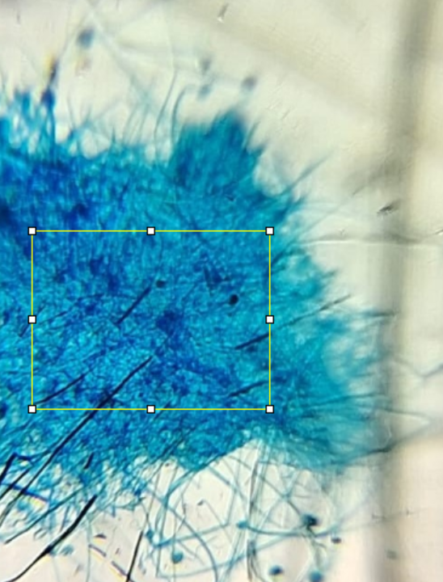
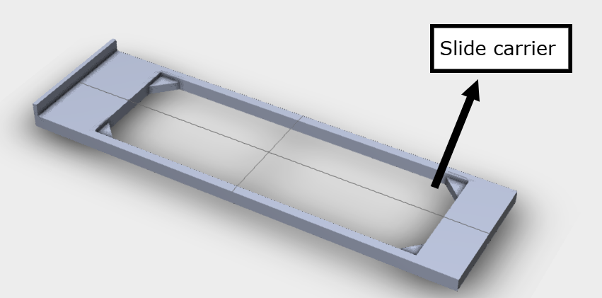
Micro-cam
Model working :-
NAME | TRADTIONAL MICROSCOPE IMAGE | MICRO-CAM IMAGE
Aspergillus (Microorganism)
Fig 1: CAD Image
Lead to the development of a cost-effective microscope that is highly comparable to the benchtop microscopes and is used to identify microorganisms and various other samples.
*Research paper Selected at IEEE indicon 2024
( Smartphone Based Identification of Microorganisms )
Fig 3: Micro-Cam Prototype
Fig 2: Slider CAD

